Slide 1
Introduction to Queueing Theory
Math 319
Prof. Andrew Ross
Eastern Michigan University

Slide 2
What is Queueing Theory?
A queue = a line of people or things waiting to be served
Queueing Theory: ways of predicting how long the line or the wait will be, or deciding on how many servers to have
Some people spell it queuing rather than queueing; either is acceptable (I prefer queueing)

Slide 3
Applications
Telephone call centers
Factories
Inventory
Health Care
Police/Firefighter/Ambulance
Repair technicians
Car/Truck traffic
Internet data traffic
UPS/FedEx
Machines waiting for repair
Restaurants
Etc.

Slide 4
Air Travel
Wait to find a parking space
Wait for the parking shuttle
Wait to check your bags
Wait to get through security
Wait to buy some food
Wait for your plane to arrive
Wait to board the plane
Wait for luggage to finish loading
Wait to de-ice
Wait to take off
Wait to de-ice
Wait to take off
Wait for the peanuts
Wait to land
Wait for the gate to free up
Wait to de-plane
Wait for your luggage
Wait for a taxi

Slide 5
Intuition Check
Suppose a company gets 40 calls/hour to its receptionist, who can handle 50 calls/hour on average
Mean # calls in the system will be 4
Sketch a graph with x=time, y=#calls in system when mean # in system is 4 people.

Slide 6
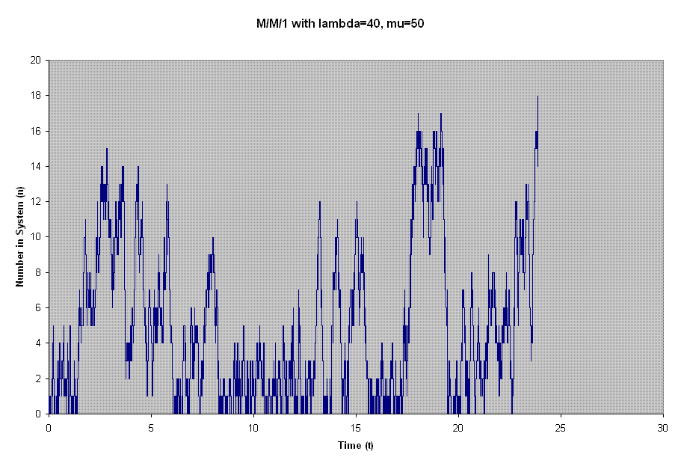
Actually,

Slide 7
Start Simple: Ignoring
Time-of-day changes in arrival rate
Job priorities
Balking (giving up before joining the queue)
Abandoning/reneging (giving up while in queue)
Retrials (trying back later after balking/abandoning)
Batch Arrivals
Batch Service
Uncertainty in arrival rate
Bilingual/Monolingual Servers (Press 1 for English…)
Virtual Hold (Press 1 and we will call you back)

Slide 8
Notation: Input Measures
lambda = arrival rate,
  e.g. 120 calls/hour, or 1 every 30 seconds on avg.
mu = service rate per server,
  e.g. 4 calls/hour = 15 minutes per call, on avg.
c = # of servers (or k, or m, or n, or s)
rho = lambda/mu = “traffic”
  e.g. rho=120 calls/hour / 4 calls/hour = 30 (unitless)

Slide 9
Notation: Output Measures
L = avg # of people or jobs in the system
  That’s in the line plus those in service
Lq = avg # of people or jobs in the queue
  Not including those in service
W = avg time spent in the system by a job
  that’s time spent in line, plus time spent in service
Wq = avg time spent in the line
Of course, W = Wq + 1/mu

Slide 10
Standard Problems
Knowing lambda, mu, and c, what will the average waiting time or line length be?
  There are some exact formulas, but not always
Knowing lambda and mu, and having a limit on the avg. waiting time, how many servers are needed?
  There is a simple approximate formula for this, but hardly ever an exact formula.

Slide 11
Basic Output Measures: when?
For queues involving people, we usually care about Wq, because once they get into service, they are happy.
At the emergency room, you want to see a doctor right away, but once you do, you don't want that doctor to rush.
For queues involving objects, we usually care about W, because as long as they are in the system, they aren't being used profitably elsewhere.
Less common to care about L or Lq—only when deciding how big the waiting area should be.
  And even then, need to plan for much more than the average.

Slide 12
Fancy Output Measures
● % of time that a server is busy (“utilization”)
  Higher is good to keep costs low
  Lower is good to keep waiting times low
  Overall, don't try to control it, except:
  Keep it under 95% (?) for human servers
● Pr(wait < 20 seconds) = 80% (?)
  Adapt to context: Emergency 911 vs IRS helpline
● Pr(had to wait at all)
● % Abandonment
● Pr(blocked) if there's a finite waiting room

Slide 13
Little's Law
● L = lambda*W, and Lq = lambda*Wq
● Along with W=Wq+1/mu
● Given any one of L, Lq, W, Wq, you can compute the other 3 easily.
● But Little's Law doesn't actually compute any of them in the first place.
● Also applies to infinite-server systems where Wq=0, W=1/mu.
● Also applies just to servers: avg # in service = arr. rate to service * 1/mu

Slide 14
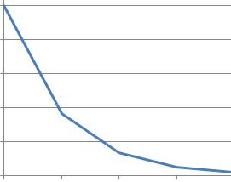
The Main Formula: Setup
Single-server system. Technical name: M/M/1
Arrivals are random according to a “Poisson Process” (Math 360/Math 419)
If you put down a dot on a timeline each time a call arrives, it looks like this:
Not at all evenly spaced! Lots of gaps and clusters.
Service times: distribution is exponential. Standard Deviation of service times is roughly equal to the mean service time. Histogram looks like this:

Slide 15
The Main Formula
Recall: rho = traffic = lambda/mu
L = rho/(1-rho)
Doesn’t depend on lambda or mu separately, just their ratio.
Calculate in your head:
rho | L
0.5
0.8
0.9
0.99

Slide 16
Make a spreadsheet & graph
L = rho/(1-rho) for an M/M/1 queue
Use: rho=0, 0.25, 0.5, 0.75, 0.9, 0.99
Use markers-with-connecting-straight lines
Now try markers-with-connecting-smooth-lines
  Why are the smooth lines bad?
If rho=0.99 and you spend 10% more money to
make the server go 10% faster, now rho=0.9
What % does L decrease?
Notes:
Smooth lines are bad because they show a decrease in a function that is actually always increasing.

Slide 17
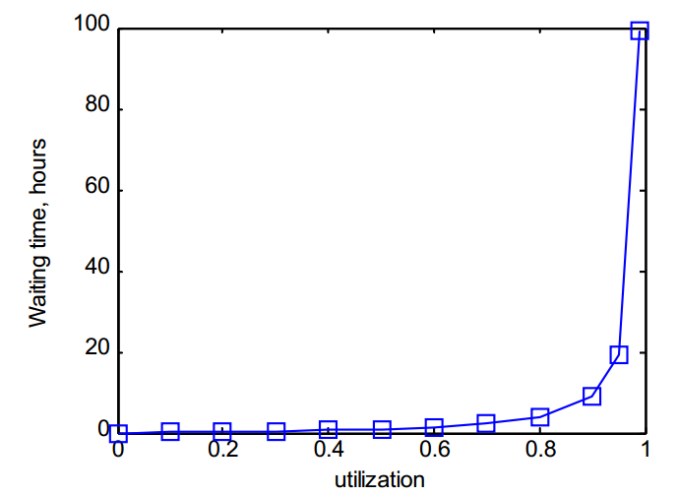
Wq for M/M/1 system

Slide 18
But Averages Aren’t Everything

Slide 19
Multi-Server as single-server?
Original System
Fast Single Server
lambda=5 calls per minute
Talk time avg: 10 minutes/call:
mu = 1/10
k=57 servers.
Erlang-C calculator gives:
Wq=21.1 seconds
Pr(not delayed) = 75.35%
lambda=5 calls per minute
Talk time avg: 10/57 min/call:
mu=57/10,
k=1 server
M/M/1: rho=50/57,
Wq=(1/mu)*rho/(1-rho)=
Wq = 75 seconds
Pr(not delayed)=1-rho=12%
Is it a good idea to approximate multi-server with a fast single server calculation?
Notes:
http://www.math.vu.nl/~koole/ccmath/ErlangC/index.php

Slide 20
Single vs Multi-Server
Single-server intuition still applies:
as rho gets large, L&W go to infinity
But the avg wait & avg # aren't the same for single vs multi-server.
Also:
  Single-server: most people are in the queue ☹
  Multi-server: most people are in service ☺

Slide 21
3 Laws of Applied Queueing Theory
Get there before the queue forms
2. At the grocery store, stay to the far left or right
(but not at tollbooths)
3. For M/M/c, you need approximately
#servers = rho + z*sqrt(rho)
z=1:good service z=2:great service
Technically, z is the Normal Distribution cutoff for
Pr(not delayed). For example, if Pr(not delayed)=85%, then z=1

Slide 22
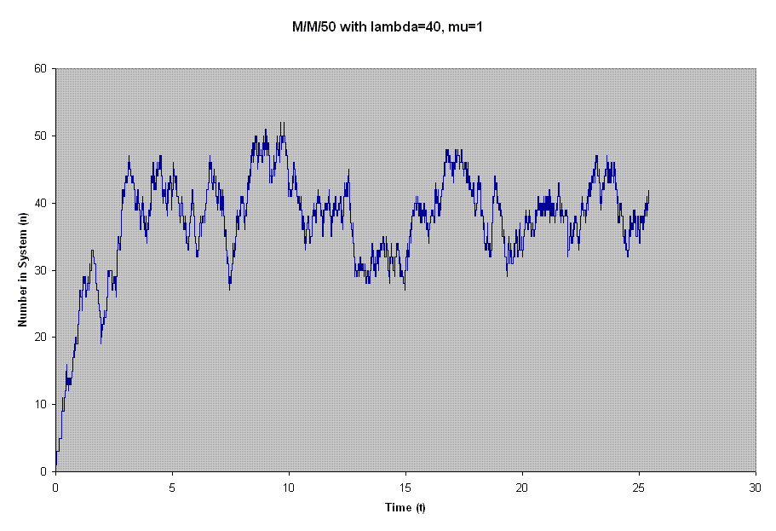

Slide 23
Practice with the 3rd Law
Also called “Square-root staffing”
If rho=10, you need 10+1*sqrt(10)=13.16 or 14 servers,
  which is 31% more than rho alone.
If rho=100, you need...
  Which is ??% more than rho alone.
If rho=1000, you need...
  Which is ??% more than rho alone

Slide 24
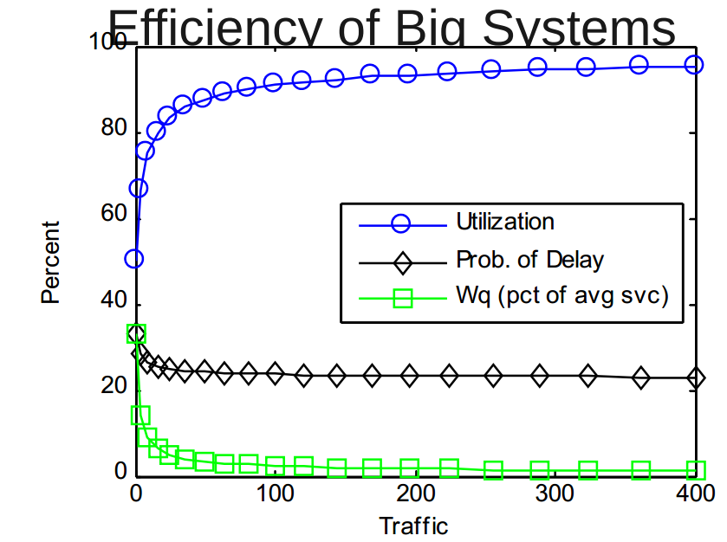

Slide 25
More on efficiency
I stopped here at traffic=400, but biggest physical call centers are about 2000 people (can get bigger by virtual grouping)
Old hospital guideline: aim for 85% utilization. Bad!
Infomercial “operators are standing by”? They are consolidated & cross-trained.
In 1978 there were 661 Poison Control Centers in the US, now there are 51, with a national 1-800 number

Slide 26
Except for Data Networks
Arrival of data packets isn't even a renewal process, let alone a Poisson Process
Shows fractal patterns!
Usually, averaging over a longer timespan reduces variability, but not for data networks.
“Where Mathematics Meets the Internet”
Walter Willinger and Vern Paxson

Slide 27
Service Ordering
First-Come-First-Serve (FCFS) or FIFO
Last-Come-First-Serve (LCFS) or LIFO
Service in Random Order (SIRO) or RSS
All of these have same averages (L, Lq, W, Wq)
FCFS has lowest wait-time variance, LCFS highest

Slide 28
Service Ordering: lower mean wait!
Shortest Job First
  needs estimate of service time for each job
Shortest Remaining Processing Time
  Also needs ability to interrupt jobs
But either can really slow down long jobs.
Round-Robin
  Each job gets a little slice of time, e.g. 5ms-30ms

Slide 29
Appointment-based queueing
E.g. dentist's office, doctor's office
No-shows are a problem: forgetfulness, etc.
  Some clinics with low-income customers see high no-shows, will triple-book appointment slots!
–Car breakdowns, Can't get time off, Can't get a babysitter
Much less academic work done on this.
A tiny trend toward only making same-day
appointments: “Advanced Access”

Slide 30
Time-of-Day arrivals?
Improving the SIPP Approach for Staffing Service Systems That Have Cyclic Demands. Linda V. Green, Peter J. Kolesar and João Soares. Operations Research, Vol. 49, No. 4 (Jul. - Aug., 2001), pp. 549-564
For call center models, if rho/mu < 1, can break it into hour-long segments and treat each independently.
If it's any worse, hire a queueing theorist.
Procedure:
  Forecast the arrival rate curve
  Decide how many servers in each time block
  Decide how many people on each shift (watch out for lunch breaks, coffee breaks, etc), “scheduling” (Math 560)
  Decide which people work which shift (“rostering”)

Slide 31
Software
Erlang-C calculators on the web & for Excel
QTS Plus
Discrete-Event Simulation:
  Arena, SIMUL8, GPSS, etc.
  http://www.lionhrtpub.com/orms/surveys/Simulation/Simulation1.html
Can hack multiserver queues in excel:
  http://www.informs.org/Pubs/ITE/Archive/Volume-7/Simpler-Spreadsheet-Simulation-of-Multi-Server-Queues

Slide 32
Bigger Issues
If you add servers to improve service, fewer people will balk/abandon, and your servers might get busier.
Game Theory—where is the equilibrium?

